Slide 1
Sales Forecasting
Process Definition and Reference Documentation

Slide 2
Version Information
This document version relates to 1.0 version of the applications.
Version no | Updated by | Comments
1.0 | Lara Eksi

Slide 3
Overall Context

Slide 4
Overview
Purpose of this document
This document is intended to describe the overall flow for the Sales Forecasting process area of the RPM applications and to detail each individual process step.
This guide outlines the standardized procedures for generating, reviewing, adjusting, and finalizing sales forecasts.
The primary goal of the Sales Forecasting App is to create a more accurate, efficient, and transparent forecasting process, leading to a reliable "single source of truth" for the company's sales outlook.
Document status
This version relates to the 1.0 release of the applications
Confidential

Slide 5
Process Context
Process | Description
Create a Single Source of Truth | To establish a unified platform that provides a single, trusted sales forecast for the entire organization.
Improve Forecast Accuracy | To leverage data-driven models and a consistent methodology to generate more reliable and accurate baseline forecasts.
Increase Efficiency | To automate manual data preparation and consolidation tasks, freeing up valuable time for strategic analysis and decision-making.
Enhance Transparency and Collaboration | To provide a clear, auditable trail of all forecast adjustments and create a collaborative environment for all stakeholders involved in the process.
Standardize the Process | To implement a single, end-to-end workflow for forecasting that is consistent across all business units and geographies.
Single Source of Truth
Improve Forecast Accuracy
Increase Efficiency
Transparency & Collaboration
Standardize the Process
Confidential

Slide 6
Sales Forecasting Functional Flow
1. Data Ingestion & Preparation
2. Baseline Forecast Generation
3. Field Sales Review & Enrichment
4. Sales Management Review & Adjustment
5. Final Forecast Submission
Historical Data, CRM Opportunities, Quota Information, Product & Customer Master Data
Prepared historical and opportunity data
System-generated "Stat Forecast."
The "Sales Submission" from the field team
The final "Management Forecast."
Automated process extracts and loads cleansed source data into the Anaplan model
Sales Ops triggers the Anaplan process to run the statistical forecasting models
Sales reps review and adjust the baseline forecast with their deal-level insights.
Sales leaders review forecasts for region and make high-level "top-down" adjustments
After all reviews, the final forecast is locked and submitted for the period.
Staging models in Anaplan are populated with the latest historical and pipeline data.
A baseline, system-generated forecast. Forecast is created for each sales territory/segment
"Sales Submission," reflecting both statistical analysis and field-level expertise
An adjusted forecast, now called the "Management Forecast."
A single, approved "Final Forecast" that becomes the official record for the company
Confidential

Slide 7
Sales Forecasting Functional Flow
1. Scenario Planning
2. Opportunity Adjustment
3. Anaplan Prediction
4. Person-level Adjustment
5. Commit Call
Historical Data, CRM Opportunities, Quota Information, Product & Customer Master Data
Prepared historical and opportunity data
System-generated "Stat Forecast."
The "Sales Submission" from the field team
The final "Management Forecast."
Automated process extracts and loads cleansed source data into the Anaplan model
Sales Ops triggers the Anaplan process to run the statistical forecasting models
Sales reps review and adjust the baseline forecast with their deal-level insights.
Sales leaders review forecasts for region and make high-level "top-down" adjustments
After all reviews, the final forecast is locked and submitted for the period.
Staging models in Anaplan are populated with the latest historical and pipeline data.
A baseline, system-generated forecast. Forecast is created for each sales territory/segment
"Sales Submission," reflecting both statistical analysis and field-level expertise
An adjusted forecast, now called the "Management Forecast."
A single, approved "Final Forecast" that becomes the official record for the company
Confidential

Slide 8
Sales Forecasting – Process Catalogue
Process Step | Reference | Key Pages | Description
Scenario Planning | 1.0 | 1.1 - 1.6
Opportunity Adjustment | 2.0 | 2.1 - 2.6
Anaplan Prediction | 3.0 | 3.1 - 3.6
Person-level Adjustment | 4.0 | 4.1 - 4.6
Commit Call | 5.0 | 5.1 - 5.6
Confidential

Slide 9
Process Steps Descriptions

Slide 10
Master Data & Hierarchy Management

Slide 11
Master Data & Hierarchy Management - Key Concepts
Creating the Structural Backbone: This process is about establishing the essential hierarchies that define the business. It answers the questions:
  Who? (Sales Hierarchy: How do individual reps roll up into districts, regions, and national views?)
  What? (Product Hierarchy: How do individual SKUs roll up into product families and business units?)
  Where? (Customer/Geographic Hierarchy: How are customers segmented or grouped into territories?)
Data Integrity and Governance: The core principle is ensuring the master data is clean, consistent, and accurate. Any errors in these foundational lists (e.g., duplicate customers, incorrect product categories, outdated sales territory assignments) will create inaccuracies throughout the entire forecast.
Single Source of Truth for Structure: This process ensures that there is one, and only one, official version of the company's hierarchies used for forecasting. This prevents the common problem of different teams using slightly different roll-up structures and getting different results.
Enabling Correct Aggregation and Analysis: Without properly managed hierarchies, you cannot correctly aggregate (roll-up) a forecast from the individual sales rep level to a national view, or slice and dice the forecast by product line. This process makes meaningful analysis possible.
Confidential

Slide 12

Master Data & Hierarchy Management - Process
In
Automated process extracts and loads cleansed source data into the Anaplan model
Out
Historical Data, CRM Opportunities, Quota Information, Product & Customer Master Data
A baseline, system-generated forecast. Forecast is created for each sales territory/segment
Cal based
Confidential

Slide 13
Master Data & Hierarchy Management - Parameters
Parameter | Purpose
Model Time Scale | Defines when the forecast applies and ensures all data is aligned on the same timeline.
Data Files | Defines all data needs for the model and accurate forecasting.
Confidential

Slide 14
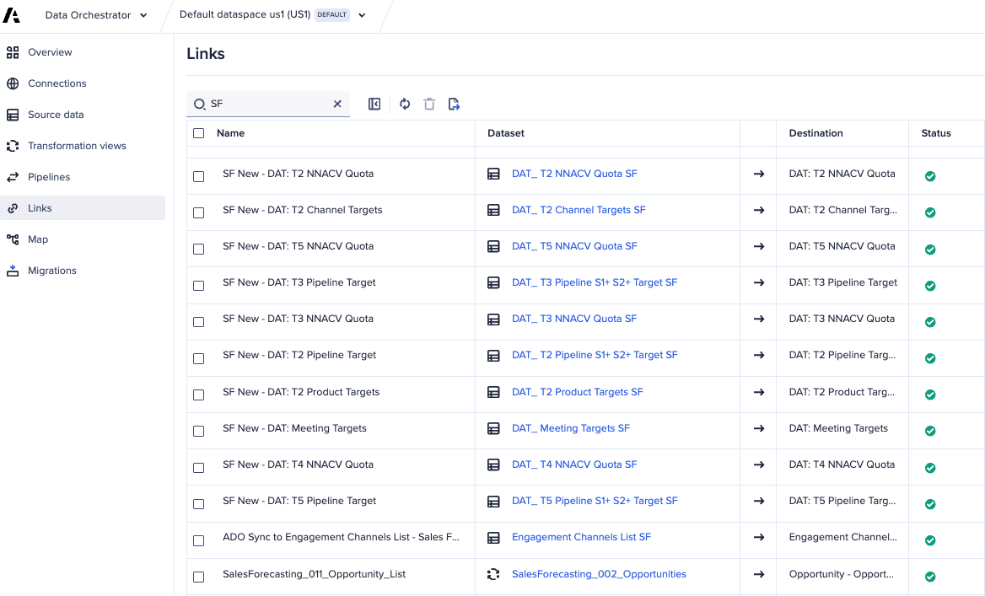
Master Data & Hierarchy Management – Key Screens
Data Orchestrator
Add data files
Transform data files
Create links to load data into the model
Confidential

Slide 15
Master Data & Hierarchy Management - Hints and Tips
Centralize Data Flows: Use ADO to replace manual staging models by having it store and transform data before pushing to Anaplan, ensuring a clear, manageable data lineage.
Optimize Performance with Parallel Workflows: In ADO Workflows, convert sequential steps to parallel processing (up to 5 concurrent syncs) to significantly shorten data loading times, particularly for independent data loads.
Leverage Push-Based Scheduling: Shift away from pull-based actions triggered inside Anaplan. Instead, use ADO to push data from external systems as soon as it is ready, increasing reliability.
Use Built-in Transformations: Utilize ADO's transformation capabilities—such as renaming columns, filtering, and aggregating data—before it hits the target model to reduce model complexity.
Handle Data Formats Carefully: Ensure that file names, time formats, and data types match exactly what is expected in the target module to avoid ingestion errors, particularly with file uploads.
Leverage "Upsert" for Data Integrity: When pushing data from ADO to Anaplan lists or modules, use the "Upsert" action to update existing records and insert new ones efficiently.
Data Validation and Reconciliation: Build in validation steps within your pipeline (e.g., checking row counts or checksums) to ensure data accuracy.
Manage Large Files: Be aware of the 1GB file size limit per upload; if necessary, break large datasets into smaller chunks.
Confidential

Slide 16
Master Data & Hierarchy Management - Implementation and Configuration Considerations
Automate from a Single Source of Truth:
  Identify and integrate directly from the official source system for each hierarchy (e.g., HRIS for people, CRM for customers, ERP for products).
  Avoid manual file uploads; use automated data feeds into a central Anaplan "Data Hub" model.
Design for Business Reality:
  Build hierarchies to the right level of detail needed for reporting, but no deeper.
  Ensure the model can handle real-world structures like reorganizations and uneven ("ragged") hierarchies.
Establish Strong Governance:
  Assign a clear business owner responsible for the accuracy of each data source.
  Create a formal process for managing changes to hierarchies (e.g., territory realignments, new hires). Use effective-dating to preserve historical accuracy.
Use Anaplan Best Practices:
  Use Numbered Lists for stable, unique IDs.
  Configure Selective Access to ensure users only see their own data.
  Implement Application Lifecycle Management (ALM) to move changes safely from development to production.
Confidential

Slide 17
Historical & Actuals Data Loading

Slide 18
Historical & Actuals Data Loading- Key Concepts
Looking Backwards to Predict the Future (Historical Data):
  The fundamental concept here is that a statistical forecast learns from the past. This process feeds the Anaplan model with historical sales data (e.g., the last 2-3 years of closed deals).
  This historical data is the raw material the model uses to identify crucial patterns like trends (are sales growing?), seasonality (do we sell more in Q4?), and cyclicality. Without this data, a statistical baseline forecast is impossible.
Establishing the Ground Truth (Actuals Data):
  This concept is about tracking reality as it unfolds. As the current forecast period progresses (e.g., week by week through a quarter), this process loads "actuals" – the sales that have officially closed.
  This provides the critical ability to perform variance analysis (Forecast vs. Actuals). It answers the most important question for sales leaders: "How are we tracking against the plan?" This allows for real-time course correction.
Automation and Reliability (The ETL Process):
  A core principle of this step is to be as automated and "hands-off" as possible. The process uses an ETL (Extract, Transform, Load) workflow to pull data from a trusted source (like the Data Warehouse) and load it into Anaplan.
  This automation ensures the data is timely, consistent, and reliable, removing the risks and delays associated with manual data gathering and uploads. It guarantees everyone is working from the same set of numbers.
Confidential

Slide 19
Historical & Actuals Data Loading- Process
In
ADO
Out
Prepared historical and opportunity data
Staging models in Anaplan are populated with the latest historical and pipeline data.
Cal based
Confidential

Slide 20
Historical & Actuals Data Loading - Parameters
Parameter | Purpose
Transaction Value | The monetary value of the sale. This is the core metric being forecasted.
Transaction Date | The date the sale was officially closed or booked
Product Identifier | The unique code for the product or service that was sold
Customer Identifier | The unique code for the customer account that made the purchase
Sales Representative Identifier | The unique ID of the sales representative credited with the sale
Quantity / Units | The number of units sold, if applicable
Confidential

Slide 21
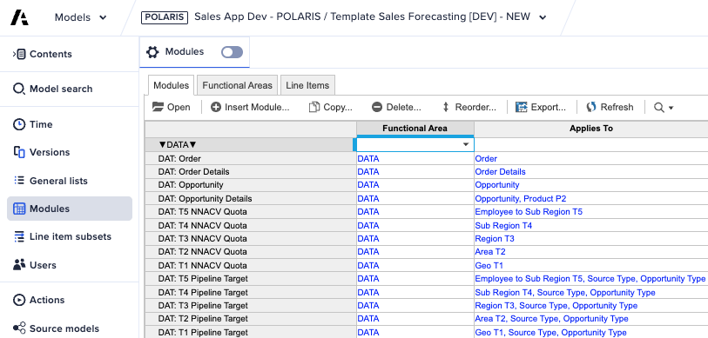
Historical & Actuals Data Loading - Key Screens
Data Modules
Import the data into the model – modules, list actions
Confidential

Slide 22
Historical & Actuals Data Loading - Hints and Tips
Clean Data Before Loading: Do data cleansing in your source system or ETL tool, not in Anaplan.
Validate All IDs: Ensure every transaction ID (Product, Customer, Sales Rep) perfectly matches an item in your master data hierarchies to prevent data rejection.
Automate Everything: Avoid manual CSV uploads for production. Build reliable, automated integrations with error notifications from day one.
Use Staging Modules: Load data into a temporary "staging" area in Anaplan first. This allows you to check and validate it before pushing it into the final model.
Load Only What You Need: To maximize performance, aggregate data to the right level (e.g., load daily data instead of hourly) before it enters Anaplan.
Account for History: Be aware of major past events (like mergers or market shifts) that could skew the historical data and mislead the forecast. Adjust accordingly.
Confidential

Slide 23
Historical & Actuals Data Loading - Implementation and Configuration Considerations
In Your Integration Tool (e.g., CloudWorks, MuleSoft)
  Use a Service Account: Configure connections using a dedicated integration user, not a person's account.
  Map and Schedule: Map the fields from the source view to the Anaplan import action. Schedule the job to run automatically (e.g., nightly) and configure email alerts for any failures.
In Your Anaplan Model
  Use a Data Hub Model: Follow best practices by loading data into a central "Data Hub" model, not directly into the main user application.
  Create a Staging Module: Build a simple, flat module to receive the initial data load.
  Build an Import Action: Create the specific import action in Anaplan that your integration tool will trigger.
  Validate Before Committing: Use other modules to validate the data from the staging area. Only after it's confirmed to be clean and correct should it be moved into the final data modules that the main Sales Forecasting app will read from
Confidential

Slide 24
Baseline Forecast Generation

Slide 25
Baseline Forecast Generation - Key Concepts
Creates an Unbiased Starting Point: It generates a purely statistical forecast based only on historical data, removing human emotion and bias from the initial number.
Automates Manual Work: It replaces the time-consuming process of creating a baseline in spreadsheets with a "one-click" action in Anaplan, freeing up significant time for the sales team.
Provides a "First Draft," Not the Final Answer: The goal is not perfection, but to provide a reasonable, data-driven foundation that the sales team can quickly refine with their expert, real-time knowledge.
Confidential

Slide 26
Baseline Forecast Generation - Process
In
Sales Ops triggers the Anaplan process to run the statistical forecasting models
Out
Prepared historical and opportunity data
A baseline, system-generated forecast. Forecast is created for each sales territory/segment
Cal based
Confidential

Slide 27
Baseline Forecast Generation - Parameters
Parameter | Purpose
Input Data Parameters | The specific dataset(s) the model will use to learn from
Time-Related Parameters | The timeframe settings that define the scope of the calculation
Model Configuration Parameters | The settings that control the statistical algorithm itself
Hierarchy & Granularity Parameters | The level of detail at which the forecast is calculated
Confidential

Slide 28
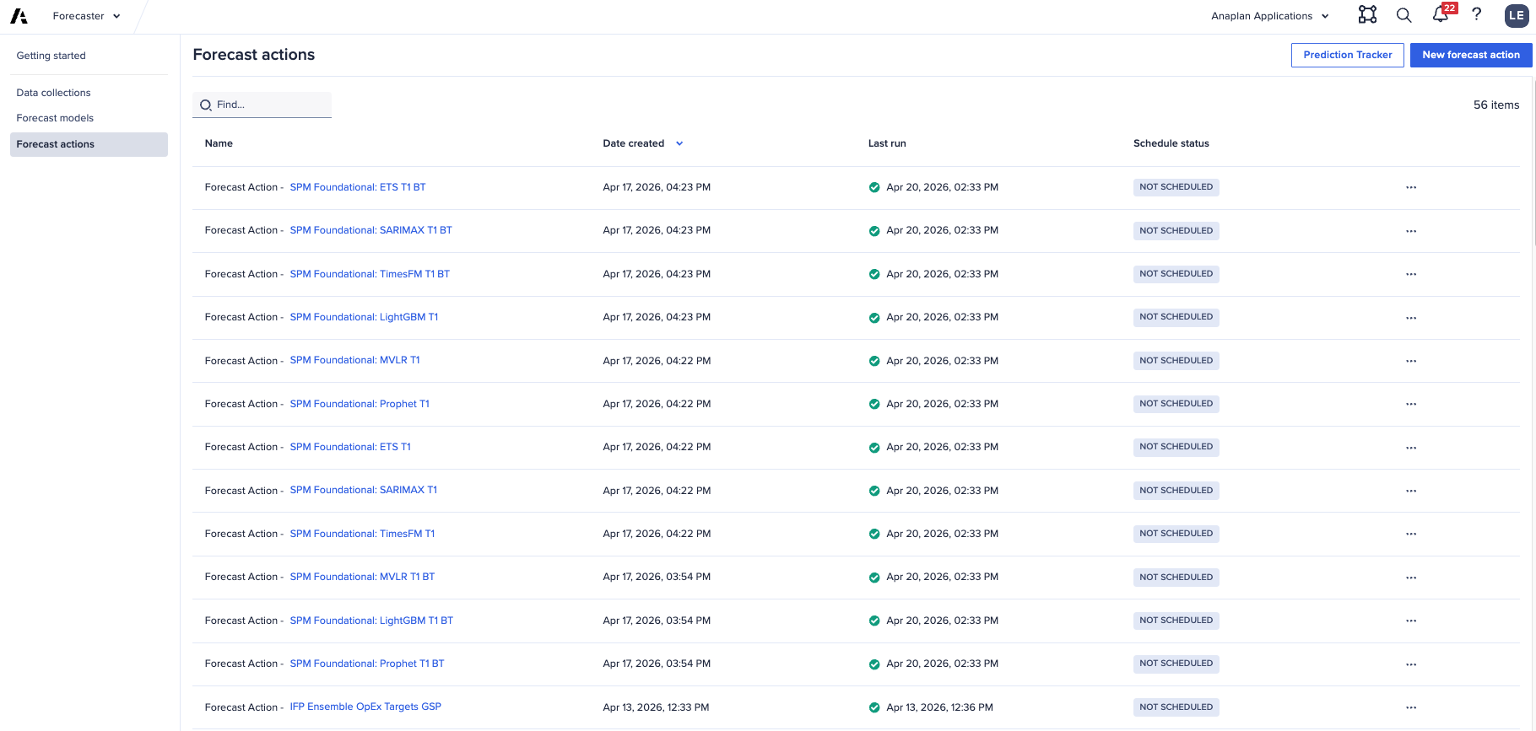
Baseline Forecast Generation - Key Screens
Forecaster
Generate data collections to compile all historical data needed for forecaster
Build a forecaster model for each algorithm to allow the most accurate forecast
Create forecaster actions to trigger the models and generate a forecast for each hierarchy node
Confidential

Slide 29
Baseline Forecast Generation - Hints and Tips
Prioritize Data Quality: Ensure historical data is clean and consistent. Forecaster helps identify gaps, but manual removal of outliers or handling zero-values before running the model improves accuracy.
Leverage Automated ML Models: Use "Best Fit" to allow Anaplan's ML engines to evaluate data and select the best algorithm among alternatives like Prophet or XGBoost.
Use Related Data for Context: Improve accuracy by incorporating external factors (e.g., promotional calendars, inflation rates, or weather data).
Opt for Coarser Granularity: Follow the "granularity = responsibility" principle to improve statistical stability, as too much detail often reduces accuracy.
Implement Backtesting: Use a "backtest window" (e.g., forecasting the last 12 months using older data) to evaluate model performance before deploying.
Structure Your Data: Create dedicated, clearly named saved views for source modules to easily identify historical data, attributes, and results.
Manage Capacity: Keep an eye on "planning units" (SKU/location combinations) as they consume allocated quota per run
Confidential

Slide 30
Baseline Forecast Generation - Implementation and Configuration Considerations
Create a Settings Module (SYS | Forecast Settings):
  Build a simple module for administrators to control the key forecast parameters (e.g., Historical Period to Use, Forecast Method).
Build the Calculation Module (CALC | Baseline Forecast):
  This is the engine. Create a module dimensioned by your forecast granularity (e.g., Product Family, Territory, Time).
  Use Anaplan's FORECAST() function in a line item here, pointing to your historical data and the settings from the module above.
Create a Results Module (DAT | Stat Forecast):
  Create a separate, formula-free module with the same dimensions. This module will store the final baseline forecast numbers. This is a critical performance best practice.
Create an Action:
  Build an Anaplan Action that copies the result from the CALC module into the DAT module.
Confidential

Slide 31
Forecast Review and Adjustment

Slide 32
Forecast Review and Adjustment - Key Concepts
The "Bottom-Up" Forecast: Applying Field Intelligence
This is where sales reps, who are closest to the customer, enrich the statistical baseline. They use their real-time, deal-level knowledge (e.g., "this deal is closing early," "that customer's budget is frozen") to adjust the system-generated number and submit their own "Commit." This adds essential human intelligence that a machine cannot have.
The "Top-Down" Forecast: Adding Strategic Judgment
This is where sales managers apply a higher-level, portfolio view. They review their team's combined submissions and add a "Management Overlay" to account for broader factors an individual rep might not see, such as regional market risks, competitive threats, or the potential lift from a new marketing campaign. This provides crucial risk management.
Creating a Transparent, Collaborative Forecast
This process brings the "science" (the baseline) and the "art" (human judgment) together in one system. By combining the statistical forecast, the reps' bottom-up submissions, and the managers' top-down adjustments, it creates a single, auditable forecast number. This transparency builds trust and accountability for the final number across the organization.
Confidential

Slide 33

Forecast Review and Adjustment - Process
In
Sales reps review and adjust the baseline forecast with their deal-level insights.
Sales leaders review forecasts for region and make high-level "top-down" adjustments
Out
System-generated "Stat Forecast."
An adjusted forecast, now called the "Management Forecast."
User input
User input
Confidential

Slide 34
Forecast Review and Adjustment - Parameters
Parameter | Purpose
Stat Forecast | The system-generated baseline forecast for their territory. This is the starting point.
Open Opportunity Pipeline | A live view of their open deals from the CRM for the forecast period.
Historical Sales | Their territory's sales performance from previous periods.
Quota / Target | Their sales goal for the period.
Sales Submission | The number the rep is committing to. This is a manual input field where they can either accept the Stat Forecast or override it with their own number based on the other inputs.
Aggregated Values | The aggregated view of a manager’s team Quota, Target, Sales Submission, etc
Management Adjustment / Overlay | A high-level adjustment amount (positive or negative) that the manager applies to their team's total forecast. They do this to account for broader risks or opportunities their team may not see. This is the primary "top-down" input.
Confidential

Slide 35
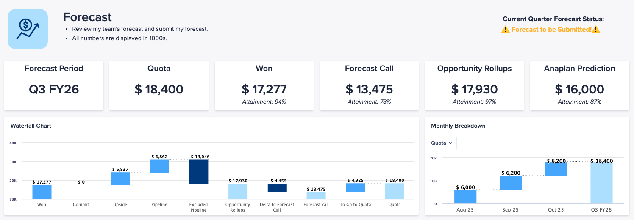
Forecast Review and Adjustment - Key Screens
1.1 Forecast
Review forecast values, won, commit, pipeline, etc
Adjust own forecast
Review / adjust team’s forecast
Submit/lock forecast for the period
Confidential

Slide 36
Forecast Review and Adjustment - Hints and Tips
Tips for Sales Representatives (Bottom-Up)
  Justify Your Adjustments: Your commentary explaining why you changed the forecast is as important as the number itself.
  Challenge the Baseline: Use the statistical forecast as a starting point, but focus your energy on adding your expert knowledge about specific deals.
  Flag Both Risks and Upside: A good forecast is realistic. Use comments to note potential deals that could slip out or extra deals that might pull in.
  Communicate Big Changes Early: Don't wait for the formal review to surprise your manager with a major change to a key deal.
Tips for Sales Managers (Top-Down)
  Coach for Accuracy: Use historical Forecast vs. Actuals data to help your reps identify their biases and improve their forecasting muscle.
  Manage the Portfolio: Apply your judgment to the team's total forecast to account for overall risks and opportunities that individuals may not see.
  Use Overlays for Strategy, Not Micromanagement: Your adjustment should reflect broad factors (market trends, campaigns). If you disagree with a single rep's commit, talk to them directly.
  Justify Your Own Adjustments: Provide clear commentary for any top-down overlay you apply to ensure transparency for both your team and your leadership.
Confidential

Slide 37
Forecast Review and Adjustment - Implementation and Configuration Considerations
Field Sales Dashboard (Bottom-Up) - a simple workspace for a rep to submit their forecast.
  Show Key Metrics (Read-Only): Display the user's Stat Forecast, Open Pipeline, and Quota.
  Provide Input Fields (Editable): Create a grid where the user can enter their Sales Submission number and provide a justification in a Commentary text field.
  Include a "Submit" Button: A single button to signal their forecast is complete.
Sales Management Dashboard (Top-Down) - a roll-up view for a manager to review their team and apply their strategic judgment.
  Show Team Roll-up: Display aggregated totals for the team's Sales Submission vs. their Quota.
  Enable Drill-Down: Provide a grid showing each team member's submission and, most importantly, their Commentary.
  Provide Adjustment Fields (Editable): Create a simple input area for the manager to enter a Management Adjustment / Overlay and a corresponding Manager Commentary.
Core Anaplan Backend Configuration
  Central Input Module: Create one main module to hold all forecast data (Stat Forecast, Sales Submission, Management Adjustment, etc.) to keep the model organized.
  Selective Access: Configure user permissions so that reps can only edit their own data and managers can only adjust their own team's roll-up. This is essential for security and data integrity.
Confidential

Slide 38
Forecast Review and Adjustment

Slide 39
Forecast Review and Adjustment - Key Concepts
The "Bottom-Up" Forecast: Applying Field Intelligence
This is where sales reps, who are closest to the customer, enrich the statistical baseline. They use their real-time, deal-level knowledge (e.g., "this deal is closing early," "that customer's budget is frozen") to adjust the system-generated number and submit their own "Commit." This adds essential human intelligence that a machine cannot have.
The "Top-Down" Forecast: Adding Strategic Judgment
This is where sales managers apply a higher-level, portfolio view. They review their team's combined submissions and add a "Management Overlay" to account for broader factors an individual rep might not see, such as regional market risks, competitive threats, or the potential lift from a new marketing campaign. This provides crucial risk management.
Creating a Transparent, Collaborative Forecast
This process brings the "science" (the baseline) and the "art" (human judgment) together in one system. By combining the statistical forecast, the reps' bottom-up submissions, and the managers' top-down adjustments, it creates a single, auditable forecast number. This transparency builds trust and accountability for the final number across the organization.
Confidential

Slide 40
Forecast Review and Adjustment - Process
In
Sales reps review and adjust the baseline forecast with their deal-level insights.
Sales leaders review forecasts for region and make high-level "top-down" adjustments
Out
System-generated "Stat Forecast."
An adjusted forecast, now called the "Management Forecast."
User input
User input
Confidential

Slide 41
Forecast Review and Adjustment - Parameters
Parameter | Purpose
Stat Forecast | The system-generated baseline forecast for their territory. This is the starting point.
Open Opportunity Pipeline | A live view of their open deals from the CRM for the forecast period.
Historical Sales | Their territory's sales performance from previous periods.
Quota / Target | Their sales goal for the period.
Sales Submission | The number the rep is committing to. This is a manual input field where they can either accept the Stat Forecast or override it with their own number based on the other inputs.
Aggregated Values | The aggregated view of a manager’s team Quota, Target, Sales Submission, etc
Management Adjustment / Overlay | A high-level adjustment amount (positive or negative) that the manager applies to their team's total forecast. They do this to account for broader risks or opportunities their team may not see. This is the primary "top-down" input.
Confidential

Slide 42
Forecast Review and Adjustment - Key Screens
1.1 Forecast
Review forecast values, won, commit, pipeline, etc
Adjust own forecast
Review / adjust team’s forecast
Submit/lock forecast for the period
Confidential

Slide 43
Forecast Review and Adjustment - Hints and Tips
Tips for Sales Representatives (Bottom-Up)
  Justify Your Adjustments: Your commentary explaining why you changed the forecast is as important as the number itself.
  Challenge the Baseline: Use the statistical forecast as a starting point, but focus your energy on adding your expert knowledge about specific deals.
  Flag Both Risks and Upside: A good forecast is realistic. Use comments to note potential deals that could slip out or extra deals that might pull in.
  Communicate Big Changes Early: Don't wait for the formal review to surprise your manager with a major change to a key deal.
Tips for Sales Managers (Top-Down)
  Coach for Accuracy: Use historical Forecast vs. Actuals data to help your reps identify their biases and improve their forecasting muscle.
  Manage the Portfolio: Apply your judgment to the team's total forecast to account for overall risks and opportunities that individuals may not see.
  Use Overlays for Strategy, Not Micromanagement: Your adjustment should reflect broad factors (market trends, campaigns). If you disagree with a single rep's commit, talk to them directly.
  Justify Your Own Adjustments: Provide clear commentary for any top-down overlay you apply to ensure transparency for both your team and your leadership.
Confidential

Slide 44
Forecast Review and Adjustment - Implementation and Configuration Considerations
Field Sales Dashboard (Bottom-Up) - a simple workspace for a rep to submit their forecast.
  Show Key Metrics (Read-Only): Display the user's Stat Forecast, Open Pipeline, and Quota.
  Provide Input Fields (Editable): Create a grid where the user can enter their Sales Submission number and provide a justification in a Commentary text field.
  Include a "Submit" Button: A single button to signal their forecast is complete.
Sales Management Dashboard (Top-Down) - a roll-up view for a manager to review their team and apply their strategic judgment.
  Show Team Roll-up: Display aggregated totals for the team's Sales Submission vs. their Quota.
  Enable Drill-Down: Provide a grid showing each team member's submission and, most importantly, their Commentary.
  Provide Adjustment Fields (Editable): Create a simple input area for the manager to enter a Management Adjustment / Overlay and a corresponding Manager Commentary.
Core Anaplan Backend Configuration
  Central Input Module: Create one main module to hold all forecast data (Stat Forecast, Sales Submission, Management Adjustment, etc.) to keep the model organized.
  Selective Access: Configure user permissions so that reps can only edit their own data and managers can only adjust their own team's roll-up. This is essential for security and data integrity.
Confidential

Slide 45
Final Forecast Submission & Lock

Slide 46
Final Forecast Submission & Lock - Key Concepts
Final Executive Approval:
Reps formally review and accept the forecast number, taking ultimate accountability for the commitment.
Creates an Immutable Record (The "Lock"):
This is the critical system action. The forecast is submitted, locking the forecast for the period, making it read-only. This prevents any further changes and ensures the integrity of the number that was approved, creating a permanent audit trail.
Becomes the Official Company Commitment:
The locked forecast is published as the "single source of truth." It becomes the official number used by Finance for financial planning, by Supply Chain for inventory, and by leadership for tracking performance against the plan.
Confidential

Slide 47
Final Forecast Submission & Lock - Process
In
After all adjustments, the final forecast is locked and submitted for the period.
Out
The final "Management Forecast."
A single, approved "Final Forecast" that becomes the official record for the company
Submit Action
Confidential

Slide 48
Final Forecast Submission & Lock - Parameters
Parameter | Purpose
Forecast Period Selector | To target the lock action to the correct time period
Lock Forecast Action | To trigger the sequence of Anaplan actions that locks the forecast and copies the final forecast to make the period read-only.
Forecast Lock Status | This is the most critical status parameter. It drives the behavior of the entire model. All input line items are configured to be READ-ONLY if Forecast Lock Status = TRUE for that period
Forecast of Record | To store a permanent, untouchable archive of the official forecast number that was submitted. All downstream reporting and financial planning processes should source their data from this Forecast of Record.
Confidential

Slide 49
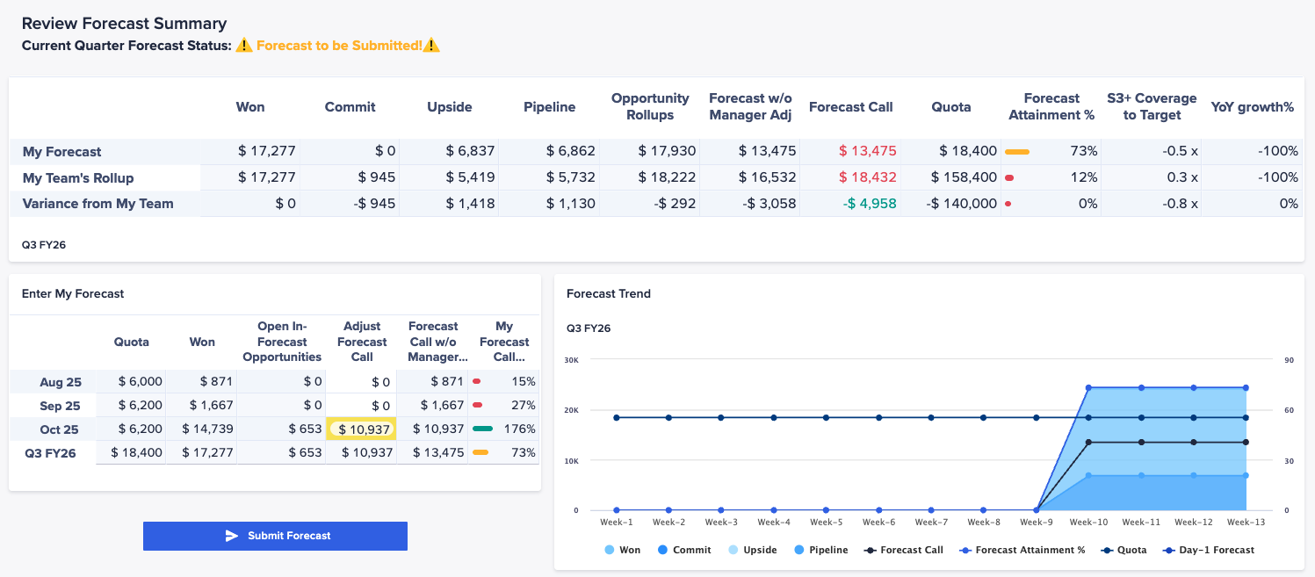
Final Forecast Submission & Lock - Key Screens
1.1 Forecast
Submit forecast values for the period
Forecast values are locked for the period and no further edits can be made
Snapshot is taken to maintain a clean record of historical forecasts
Confidential

Slide 50
Final Forecast Submission & Lock - Hints and Tips
Tips for Sales Representatives (Bottom-Up)
  Challenge the Baseline: Use the statistical forecast as a starting point, but focus your energy on adding your expert knowledge about specific deals.
  Flag Both Risks and Upside: A good forecast is realistic. Note comments potential deals that could slip out or extra deals that might pull in.
  Communicate Big Changes Early: Don't wait for the formal review to surprise your manager with a major change to a key deal.
Tips for Sales Managers (Top-Down)
  Coach for Accuracy: Use historical Forecast vs. Actuals data to help your reps identify their biases and improve their forecasting muscle.
  Manage the Portfolio: Apply your judgment to the team's total forecast to account for overall risks and opportunities that individuals may not see.
  Use Overlays for Strategy, Not Micromanagement: Your adjustment should reflect broad factors (market trends, campaigns). If you disagree with a single rep's commit, talk to them directly.
  Justify Your Own Adjustments: Provide clear commentary for any top-down overlay you apply to ensure transparency for both your team and your leadership.
Confidential

Slide 51
Final Forecast Submission & Lock - Implementation and Configuration Considerations
The Locking Mechanism (In the Model)
  Drive Editability: Use this boolean to control the "Write Access" formula for all forecast input fields (like Sales Submission). If Forecast Lock Status is TRUE, the formula should resolve to FALSE, making the cells read-only.
  Create a Snapshot: In the model, take a snapshot of the Forecast per period to permanently store the final, locked numbers.
  Reset: A process within the model to reset the Forecast Lock weekly
Confidential

